Slide 1
Phase 3

Slide 2

MaN’s
ArCaDe

Slide 3

Building Expansion
Introduction of Pitakwa reside
Introduction of merchandize (Hoodie only)
Introduction of Euphoria Hub
Introduction of Cab and Arcade Park (Parking service)
Introduction of arcade Sub
Introduction of Arcade Shelves, Shelves pro and Shelves EDU
Introduction of Arcade Scent
Introduction of Arcade Cares

Slide 4
Building Expansion
There would have to be some necessary expansions to the Dome arcade building in order to include some more services and features

Slide 5
Introduction of Pitakwa reside

Slide 6
Pitakwa reside (80SB) yearly
Pitakwa reside is a members only classy lounge for indoors recreational activities, and other elite services that only members can reap, complementary luxurious wine, classic background music, allow cash withdrawal with N10 back on each use, served imported foods from classy restaurants and Hotels, helps in booking basic reservations for services like SPAS and massages and have access to purchase of VIP lounge for Arcade Conferences.

Slide 7
Levels of membership
Type X member (less than 2 years)
Type Y member (at least 2 to 5 years)
Type Z member (at least 10 years)
Legacy member (at least 25 years)
Elite member (50 years and above)

Slide 8
With a Pitakwa reside memberships you get access to
Tick pass (entry with quick lane)
Reservations
Access to Lounge
Monthly Magazine
Access to Arcade Cab pro once a week
Complimentary drinks
Access to Wi-Fi and bring devices
No weekly entrance fee or toilet fee

Slide 9
merchandize (Hoodie only)

Slide 10
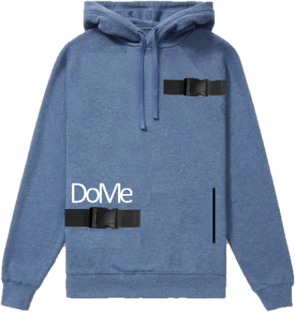

Merchandize Hoodie
only 50,000 made annually
New color way Releases on October 28
Contains: 2 plastic belts, waterproof interior, zip able pouch, zipable base, Glow in the dark “arcade”
Can't be bought on point (13 days)
14 Studio bucks or (₦35,990) only
To buy after sold out 18SB or (₦45,000)
10% off for Kids (10 years max)

Slide 11
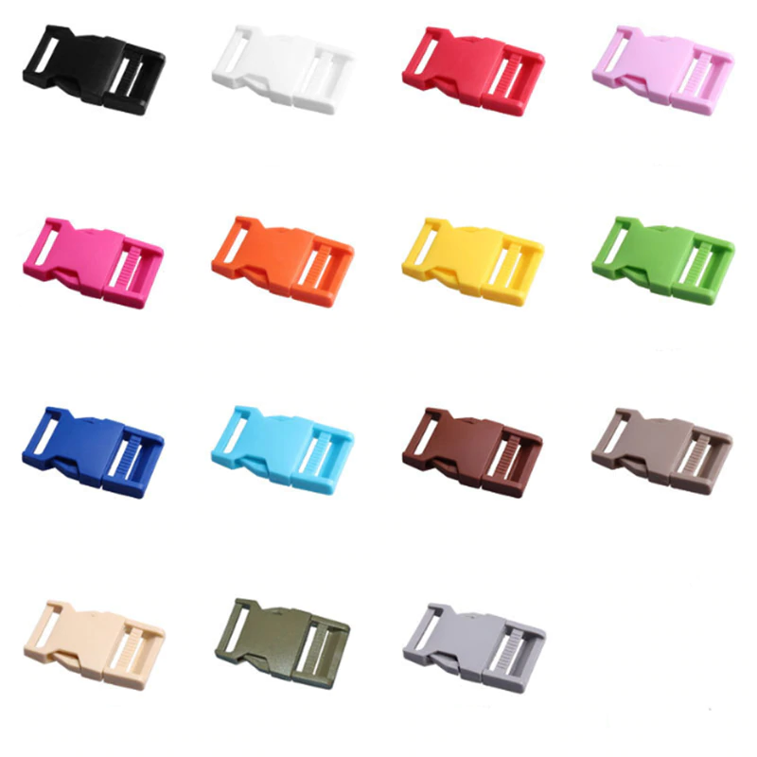
belt buckle
1SB
Per piece

Slide 12
Introduction of Euphoria Hub

Slide 13
Euphoria hub (for arcade sub subscribers )
This is an environment contains Arcade sub pods like the ones in studio room but generally for using the Arcade Sub subscription, for ordering food from foresté, hosting minor Calendar activities, waiting lounge etc. and other activities that it is needed for

Slide 14
Arcade Cab and Park

Slide 15
Arcade Cab (1SB for 21 days of access)
Get access to an official that takes you to the nearest Dome arcade from anywhere you are in port Harcourt and at at any time you want all at the click of a button, in the dome arcade mobile app you would be greeted with a warm and seamless interface when attempting to use our services, all you would have to do is click the (find me) button and a loading screen would show up with the starting point (0%) as the chauffer's location and the ending point (100%) as your current location, then you would only be able to call the chauffer when the loading screen is at 95% to reduce the risks from driving and calling. A similar loading screen would show up when you are returning.

Slide 16
To promote our Arcade Cab services and to regulate the parking spaces we would have to introduce a relatively cheap subscription for renting spots at our parking lot. Pay for parking (N1050 weekly).
While for only N830 weekly a more seamless, less stressful yet more affordable service we have to offer, our arcade Cab subscription which allows you to get picked up from wherever you are in the city and get dropped off at the nearest arcade, then when your done having a great time let us know and you’d get dropped off back where we picked you up from. Don’t worry about paying now we have you covered.
A similar approach was taken to also regulate the number of people using our luxurious high standards screaming Toilets.
By subscribing at only N299 you get 3 whole months of uninterrupted access, a complimentary disinfected noise cancellation headphone and sit cushion, a Variety of tissue, hand soap, hair gel, Cream, Mouth wash, Mint brands and a shower place to cool off. You also get a free trial for 48 hours in case of an emergency.

Slide 17
Chauffeurs requirements
They would be payed N2m every 2 years of work to provide their services at any time of the day throughout the 2 years
(expected to work 5 times a day everyday) 200 drivers expected at launch
Car must be painted purple with the space like interior of the arcade
Build arcade cab camp for the drivers recreational activities and housing
The chauffer's would be provided with (an apartment and food) after 2 years of work
4.5Gb free wi-fi monthly provided in each car for the customers
Free mint, pillow, snack, water, charging, AC and song picks
Free old iPad and headphones to be used inside the car only for a more conducive ride

Slide 18
Introduction of arcade Sub

Slide 19
Reduction of theft and piracy
Due to the risk of forgetfulness and mobile theft, Dome arcade studio has taken the brave decision to default at not allowing the use of mobile devices and Computers. Knowing that some individuals simply have so many needs that can only be granted with the access of their mobile devices, we have created a way to limit the number of customers with phones in the arcade by creating two solutions

Slide 20
Arcade sub subscription
Get a complete access to the latest and greatest generations of iPad and Apple air pods max complemented with all your favorite expensive and free games, apple music, YouTube premium, Netflix, Prime videos, Disney+, CBS, ABC, Nordvpn, Showmax, Iroko tv, DSTV, ETC. for as affordable as N999 an hour . it can easily be accompanied with our unlimited Wi-Fi deal for only N499 more to help you experience true luxury while saving hundreds of thousands.
As it would cost us over N1,000,000 monthly to present all these expensive devices and amazing services monthly yet we are giving it to you for as low as 20 musthyds
iPads would be logged into with only biometrics to reduce theft
To get the exact same iPad as your last time pay double the price

Slide 21
Get as much as you can with the latest and greatest iPad for only 20 musthyds an hour.

Slide 22
to bring your own devices in you pay
(2SB monthly for 5 hours a day) per 5 devices
pay only 45MST only if you buy our unlimited data plan
No laptops or consoles allowed or pay (20SB) per queue of downloads (1 laptop and 1 console)
For phone submission you add password and set the lock screen picture as a selfie then get a lock in QR code printed out
Note: bringing of devices would be free until the introduction of Dome arcade Sub

Slide 23
Arcade Shelves, Shelves pro and Shelves EDU

Slide 24
Arcade shelves
Dome arcade focuses on satisfying the needs of everyone that walks in through our doors which includes those that aren't as interested in streaming and gaming so we have decided to include readers into our wide range of users by providing unlimited access to the best of comic books sold internationally in large volumes for the readers to be satisfied for only N499 weekly. Free trial is for 10 minutes of access.

Slide 25
Arcade shelves pro
Similar to the dome arcade shelves, dome arcade shelves pro gives a wide range of books ranging in all genres for those who aren't interested in flashy or comic books but in the pure literature of English, documentaries and storyline books only, Meaning for only N999 a week you would be granted an unlimited access to all you can read when you can read them. Free trial is for 30 minutes of access.

Slide 26
Arcade shelves EDU
Similar to the dome arcade shelves and Shelves Pro, dome arcade shelves EDU gives a wide range of educational books in all courses and levels of education for those who aren't interested in recreational books or don’t have access to specific books from different countries or schools. Meaning for only N1499 a week you would be granted an unlimited access to all you can read when you can read them. Free trial is for 10 minutes of access.

Slide 27
Customers can get pictures of pages or scanned texts from pictures of the pages to take home in QR code format.
N149 per pictures taken only (Per page)
N249 per scanned texts from pictures taken (Per page)
Pay N299 for official to take them for you.

Slide 28
Introduction of Arcade Scent

Slide 29
Free access to Perfumes
Unlock an access to hundreds of perfumes if you
Arcade online subscriber
Own any merchandize
(maximum of 3 sprays a day (no repetition))

Slide 30
Arcade cares

Slide 31
Tragic events community (ages 12 - 16)
A free 5 years membership to help pave the way for a brighter future to 1,000 less privilege Christian children in Nigeria every year.
The requirements are having special talents, being decisive in ambitions, having an outstanding leadership, excellent academic result.
Children would be provided with Ipads, Airpods, iphones, Wi-Fi, tuition, Food, Hospitality, clothing annually, allowances (N3k monthly) etc.
Only career parts we teach: Business, Software and hardware Engineering, Medicine, innovative engineering, architecture, Entertainment, Sports, Politics.

Slide 32
Project Hope

